Slide 1
JAMAL MOHAMED COLLEGE (AUTONOMOUS) TIRUCHIRAPPALLI -20 PG & RESEARCH DEPARTMENT OF COMMERCE (SF - MEN) N. MOHAMMED ASHIK Assistant professor Dept of commerce Jamal Mohamed college

Slide 2
ENVIRONMENTAL ANALYSIS
Environmental analysis is a strategic tool.
It is a process to identify all the external and internal elements, which can affect the organization’s performance
The analysis entails assessing the level of threat or opportunity the factors might present.
These evaluations are later translated into the decision-making process
The analysis helps align strategies with the firm’s environment.
Businesses are greatly influenced by their environment, so they must constantly analyze the trade environment and the market.

Slide 3
IMPORTANCE OF ENVIRONMENT ANALYSIS
There are many external factors other than the ones discussed.
None of these factors are independent.
They rely on each other.
It is true that industry factors have an impact on the company performance.
Environmental analysis is essential to determine what role certain factors play in your business.
PEST or PESTEL analysis allows businesses to take a look at the external factors.
Many organizations use these tools to project the growth of their company effectively.
The analyses provide a good look at factors like revenue, profitability, and corporate success.

Slide 4
PROCESS OF ENVIRONMENTAL ANALYSIS
SCANNING
MONITORING
FORECASTING
ASSESSMENT

Slide 10
Limitations of Environment Analysis
LACK OF FOREWARNING OF UNFORESEEN EVENTS: Environmental analysis does not predict the future. It does not eliminate uncertainty for the organization also. Business enterprises sometimes face events, which are unexpected during analysis.
NO ASSURANCE AS TO ORGANIZATION EFFECTIVENESS: Environmental analysis does not ensure organizational effectiveness. It acts only as inputs in strategy development and testing. Sometimes, managers place uncritical faith in the data without thinking about the data’s verifiability or accuracy. If this is the case, it may lead to misleading outcome.
NOT FULLY RELIABLE: Normally, people place too much reliance on the information collected through environmental scanning. But in practice, it is not so. When there is overloading of information, one is likely to get confused.
ABSENCE OF STRATEGIC APPROACH: Success of any organization lies in adventure and strategic risk-taking. Environmental analysis often makes an individual too cautious in his approach and he is likely to be left behind the events. So this analysis should be strategically done.

Slide 12
SWOT ANALYSIS
Strengths: factors that give an edge for the company over its competitors.
Weaknesses: factors that can be harmful if used against the firm by its competitors.
Opportunities: favorable situations which can bring a competitive advantage.
Threats: unfavorable situations which can negatively affect the business.

Slide 14
ENVIRONMENTAL THREAT AND OPPORTUNITY PROFILE [ETOP]
There are many techniques available for environmental appraisal (assessment), one such technique suggested by Glueck is ETOP the preparation of ETOP involves dividing the environment into different sectors & then analyzing the impact of each sector on the organization. The preparation of an ETOP provides a clear picture to the strategists about which sectors & the different factors in each sector have a favorable impact on the organization.
By the means of an ETOP, the organization knows where it ne stands with respect to its environment. Obviously, such an understanding can be of a great help to an organizations in formulating strategies to take advantage of the opportunities & counter the threats in its environment.

Slide 15
MEANING
ETOP is a device that considers environmental information & determines the relative impact of threats & opportunities for the systematic evaluation of environmental scanning
ETOP is an environmental analysis results in a mass of information expectations. Structuring of environmental issues is necessary to make them meaning full of strategy related to forces in the environment. They deal with events, trends, issues & formulation. In short, it is a technique to structure environmental issues
It is the process by which organizations monitor their relevant environment to identify opportunities & threats affecting their business for p purpose of taking strategic decision.
WHY ETOP?
✓ Helps organization to identify O-T
✓ To consolidate and strengthen organization’s position
✓ Provides the strategists of which sectors have a favorable impact on the organization. ✓ Helps organization knows where its stands with respect to its environment.
✓ Helps in formulating appropriate strategy.
✓ Helps in formulating SWOT analysis.

Slide 16
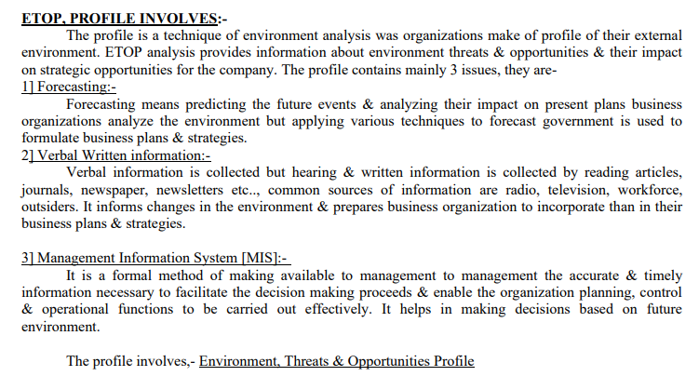

Slide 17
